Slide 1
Arithmetic Expression Evaluation
Md. Shafqat Talukder Rakin
Lecturer, Dept. of CSE
United International University
Email: shafqat@cse.uiu.ac.bd
Courtesy: Tasmin Sanjida Mam

Slide 2
Operators and Operands
Arithmetic Operator
Unary operators
Relational and logical operators
Assignment operators and
Conditional operator
The data items that operators act upon, are called operands.

Slide 3
Arithmetic Operators
There are five arithmetic operators in C. They are
There is no exponentiation operator in C.
There is a library function (POW) under math.h to carry out exponentiation
Operator | Purpose
+ | Addition
- | Subtraction
* | Multiplication
/ | Division
% | Reminder after integer division

Slide 4
Arithmetic Operators (cont.)
The operands acted upon by arithmetic operators must represent numeric values.
Thus, the operands can be integer quantities, floating-point quantities or characters
Character constant represent integer value

Slide 5
Arithmetic Operators (cont.)
The remainder operator (%) requires that both operands be integers and the second operand be nonzero.
Similarly, the division operator (/) requires that the second operand be nonzero.

Slide 6
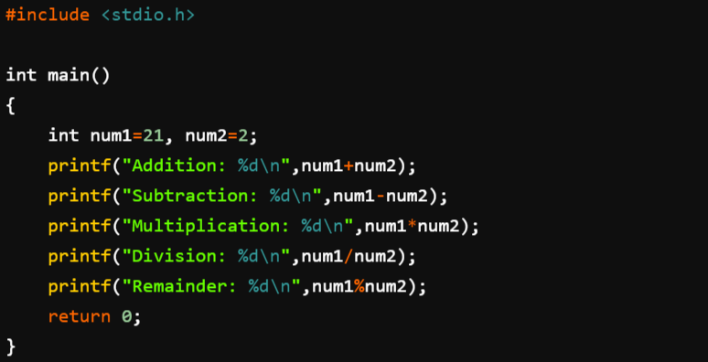
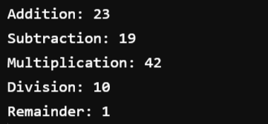
Arithmetic Operations

Slide 7
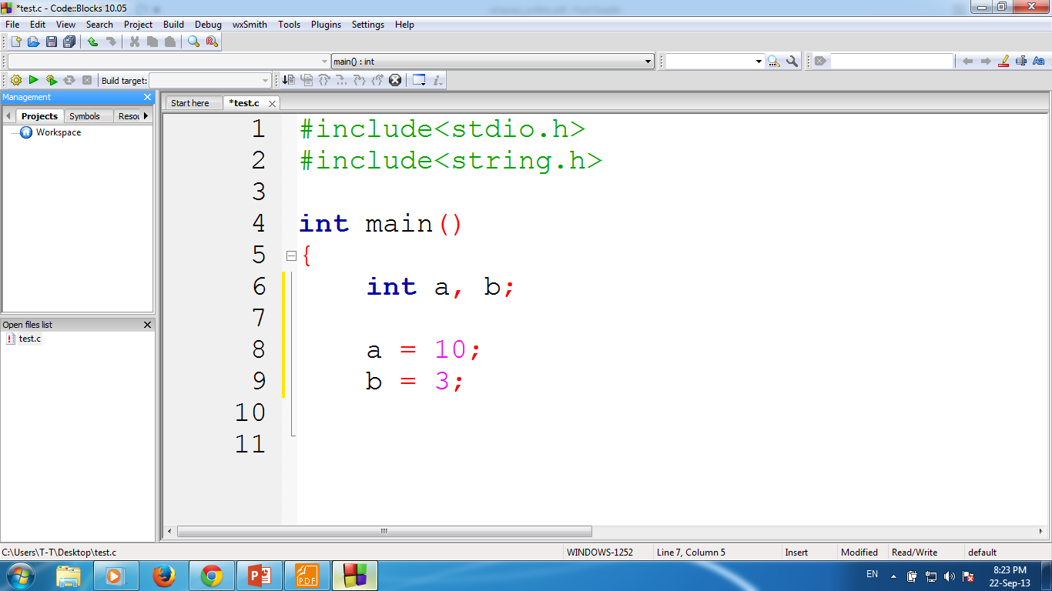
a + b
13
a - b
7
a * b
30
a / b
3
Here, the decimal portion of the quotient will be dropped
a % b
1

Slide 8
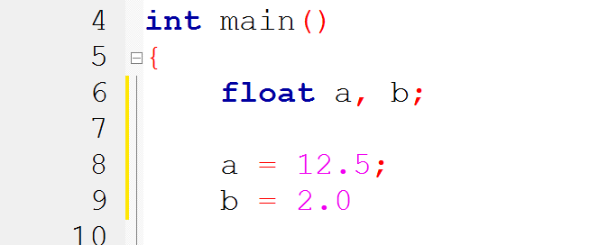
a + b
14.5
a - b
10.5
a * b
25.0
a / b
6.25
a % b
Not Possible!!!

Slide 9

a
65
a + b
131
a + 1
66
a + ‘A’
130
a + ‘1’
114

Slide 10
int a, b;
a = 11;
b = -3;
Follow basic rules of algebra
a + b
8
a - b
14
a * b
-33
a / b
-3
a % b
2
Ignore - !!!

Slide 11
Type Convention
Operands that differ in type may undergo type conversion before the expression takes on its final value.
In general, the final result will be expressed in the highest precision possible, consistent with the data types of the operands.
Rules apply when neither operand is unsigned.
We will learn detail later

Slide 12
int i = 7;
float f = 5.5;
char c = ‘w’
ASCII Value
w = 119
0 = 48
i + f
12.5
float (double)
i + c
126
integer
i + c – ‘0’
78
integer
(i + c) - (2 * f / 5)
123.8
float (double)

Slide 13
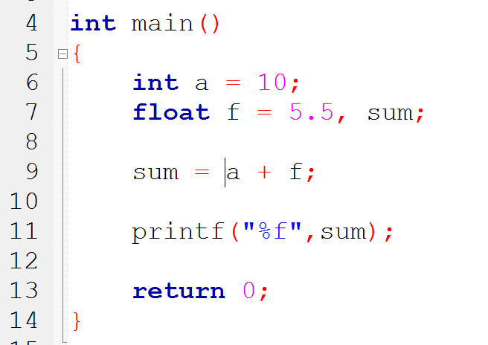

Slide 14
Type Convention (Assignment)
If the two operands in assignment expression are of different data types.
The value of right hand operand will automatically be converted to the type of the operand on the left.
The entire assignment expression will be then same data type.
Left
11.995
float
int
Right
int
3
float
Left
float
int
3.0
11
;
;
;

Slide 15
Type Cast
To transform the type of a variable temporarily.
To do so, the expression must be preceded by the name of the desired data type, enclosed in parentheses
(data type) expression
int number;
(float) number;

Slide 16
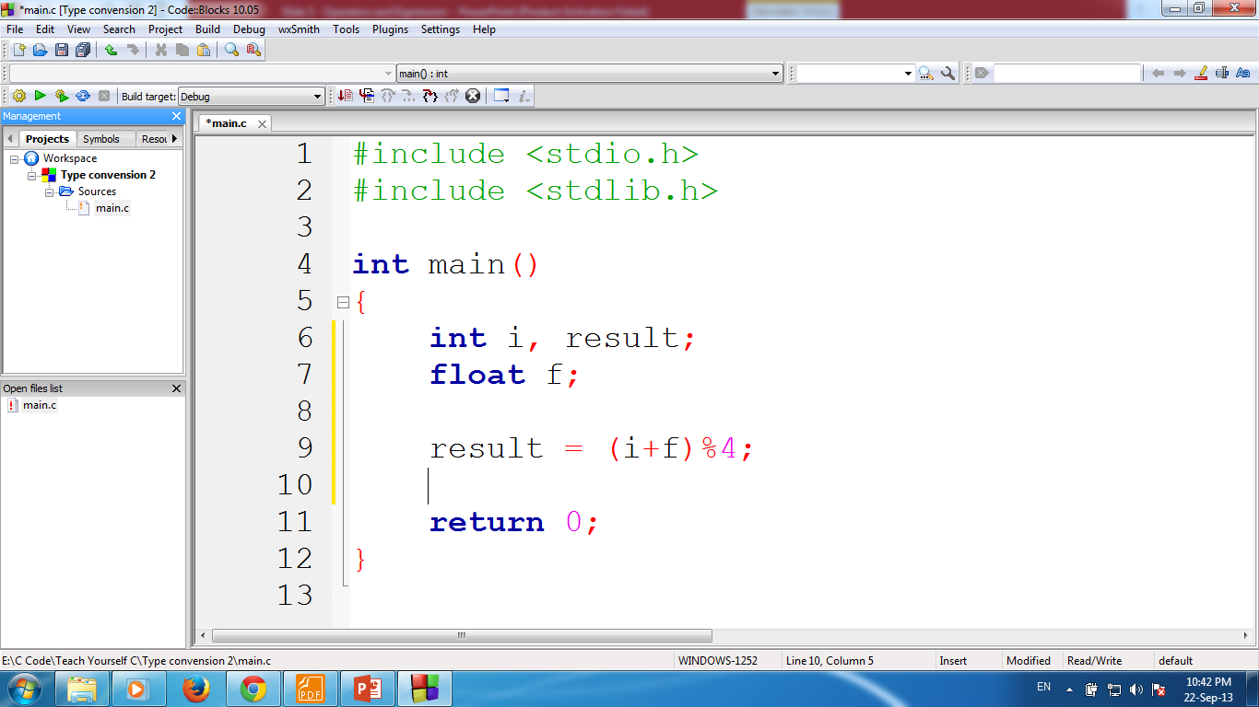
Valid or Invalid?
Type conversion 2
i = 7;
f = 8.5;
Invalid
result = (i + f) % 4;

Slide 17

Valid or Invalid?
float num = 10.5;
num % 2;
float num = 10.5;
((int)num) % 2;

Slide 18
Operators and Operands
Arithmetic Operator
Unary operators
Relational and logical operators
Assignment operators and
Conditional operator

Slide 19
Unary Operators
A class of operators that act upon a single operand to produce a new value.
Known as unary operators.

Slide 20
Unary Operators…
Perhaps the most common unary operation is unary minus (-8)
There are two other commonly used unary operators:
The increment operator, ++
The decrement operator, --
sizeof - returns the size of its operand, in bytes.
Cast - (type) expression

Slide 21
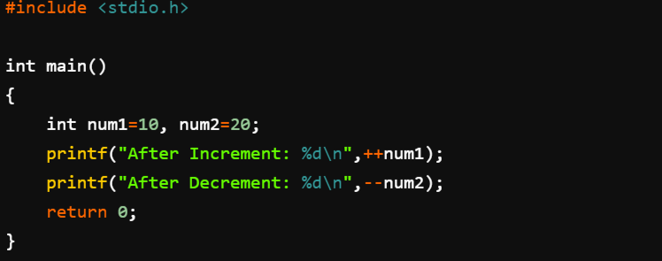

Increment & Decrement

Slide 22
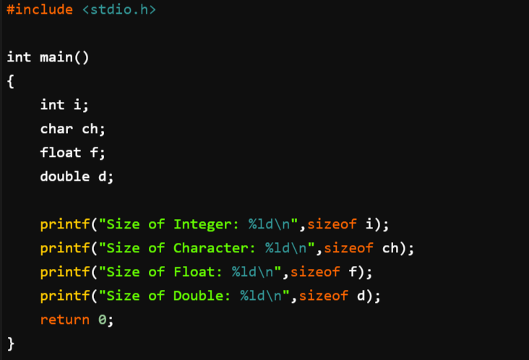
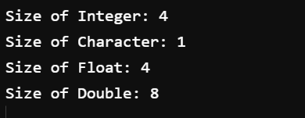
sizeof
Output

Slide 23
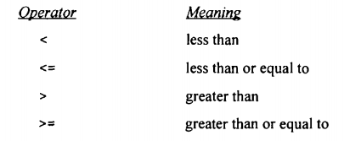
Relational Operators
There are four relational operators in C. They are

Slide 24
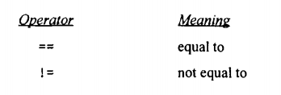
Equality Operators
For equality

Slide 25
Relational Operator
The relational operators compare two values and return a true or false result based upon that comparison.
Operator | Meaning | Type
< | Less than | Relational
> | Greater than | Relational
<= | Less than or equal to | Relational
>= | Greater than or equal to | Relational
== | Equal to | Equality
!= | Not equal to | Equality

Slide 26
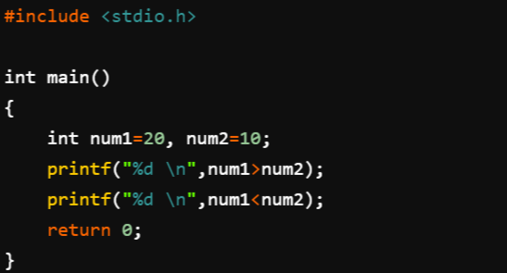

Relational Operator
Output
1 = TRUE
0 = FALSE

Slide 27
Relational Operators…
These six operators are used to form logical expressions, which represent conditions that are either true or false.
The resulting expressions will be of type integer
True is represented by the integer value 1
False is represented by the value 0

Slide 28
Examples of Conditions
Operator | Condition | Meaning
<= | x <= 0 | x less than or equal to 0
< | Power < MAX_POW | Power less than MAX_POW
== | letter == ‘M’ | Letter equal to ‘M’
!= | num != x | num not equal to x

Slide 29
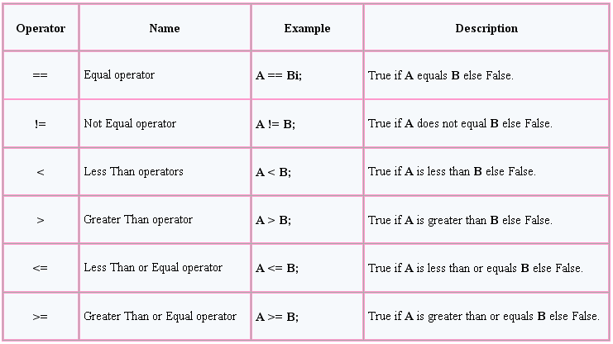

Slide 30
True or False
i = 1
j = 2
k = 3
Expression
Result
Value
i < j
true
1
(1 + j) >= k
true
1
(j + k) > (i + 5)
false
0

Slide 31
True or False
i = 1
j = 2
k = 3
Expression
Result
Value
k != 3
false
0
j == 2
true
1
(j + k) >= (i + 5)
false
0

Slide 32
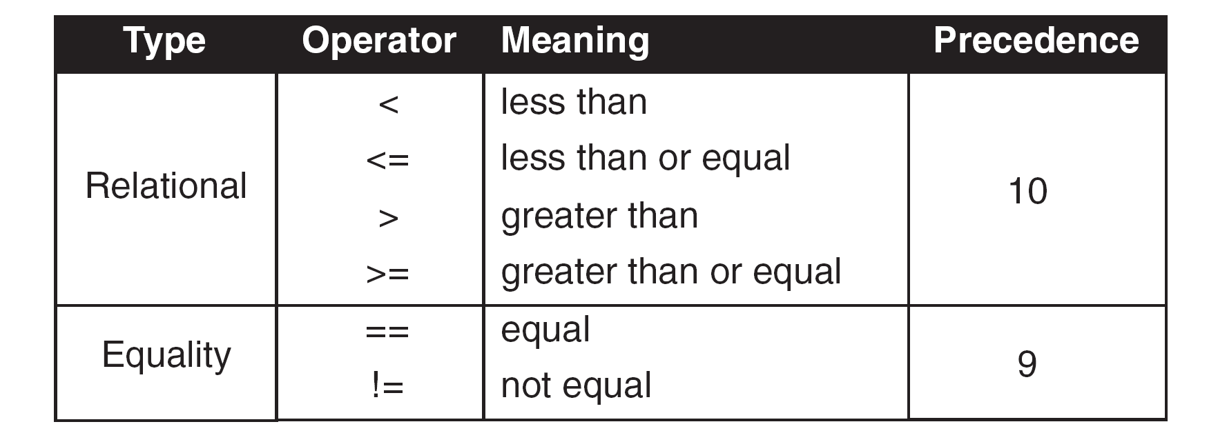
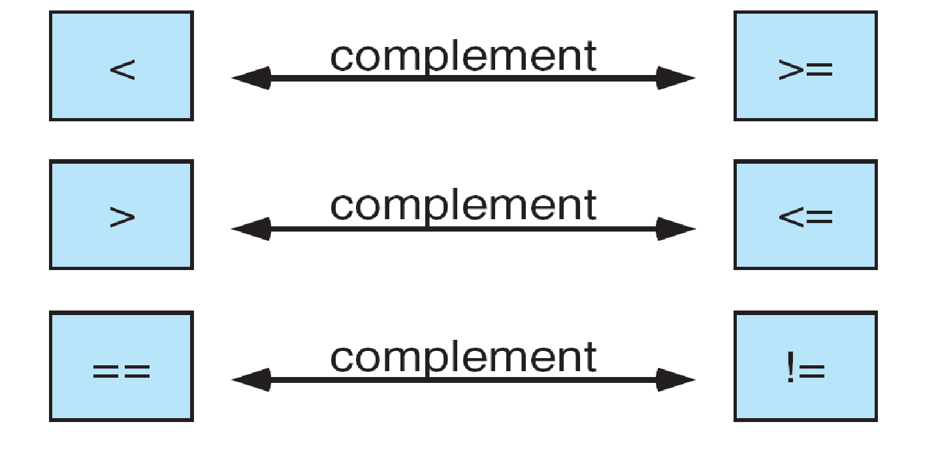

Slide 33
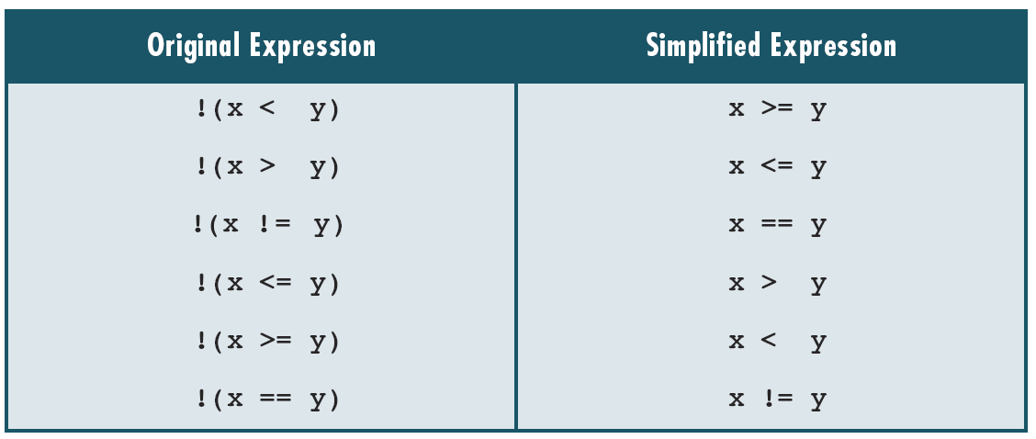
Simplified Expression

Slide 34
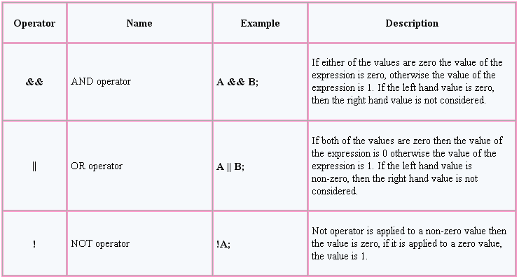
Logical Operation
There are three kinds of logical operators.

Slide 35
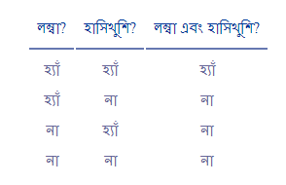
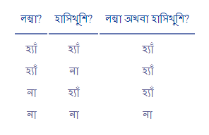
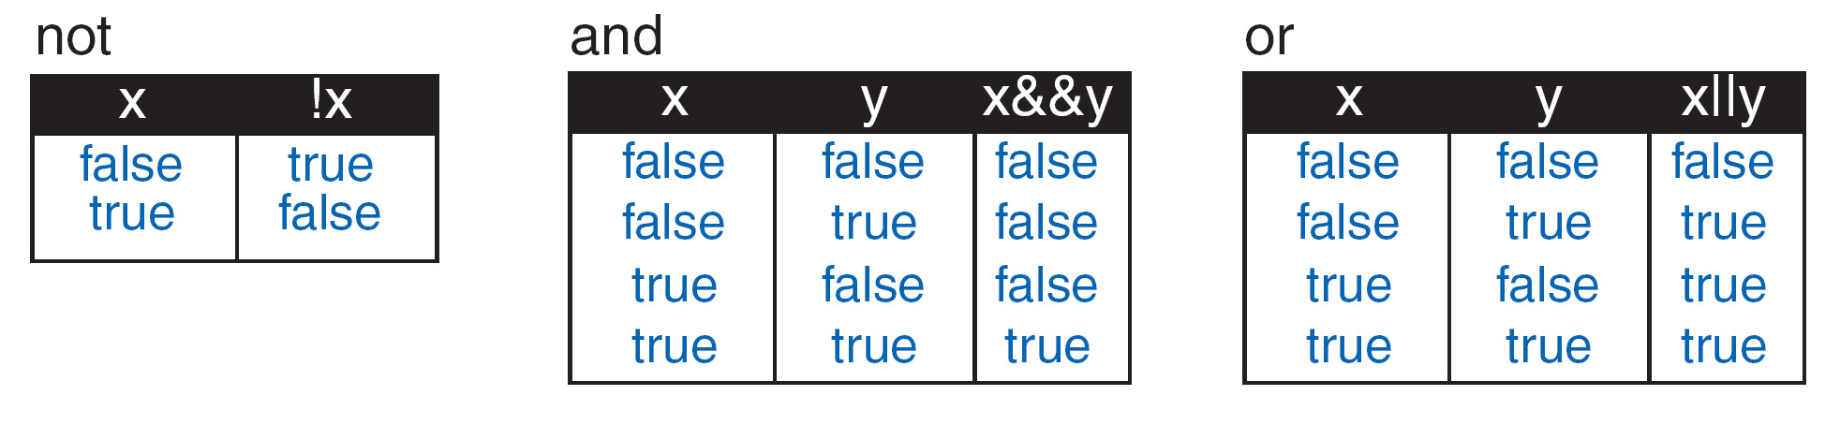
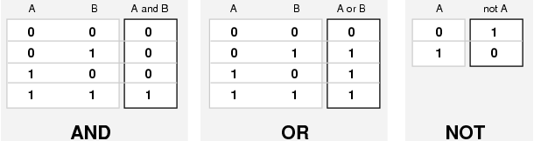

Slide 36
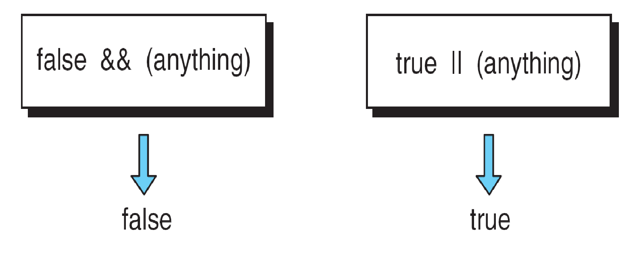
True or False!

Slide 37
True or False
i = 7
f = 5.5
c = ‘w’ (119)
Expression
Result
Value
(i >= 6) && (c == 'w')
true
1
(i >= 6) || (c == 119)
true
1
(f < 11) && (i > 100)
false
0

Slide 38
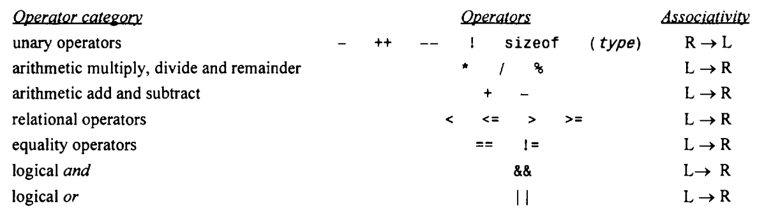
Operator Precedence
An operator’s precedence determines its order of evaluation.

Slide 39
Operators and Operands
Arithmetic Operator
Unary operators
Relational and logical operators
Assignment operators and
Conditional operator

Slide 40
Assignment operators
Most common “=“
= and == are not same!
Other five are:
+=
-=
*=
/=
%=

Slide 41
Assignment operators….
expression 1 += expression 2
is equivalent to
expression 1 = expression 1 + expression 2
Example:
Similarly, the assignment expression
expression I -= expression 2
is equivalent to
expression 1 = expression I - expression 2
sum = sum + N;
sum+=N;

Slide 42
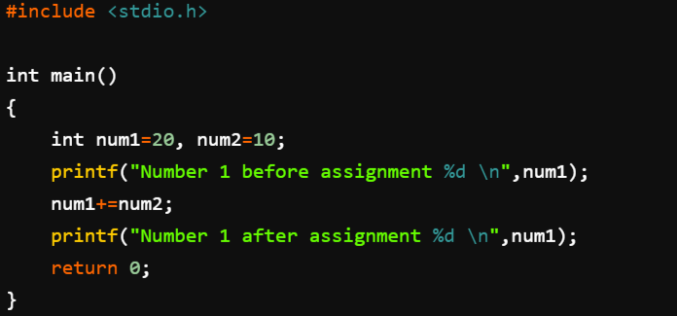

Assignment operators

Slide 43
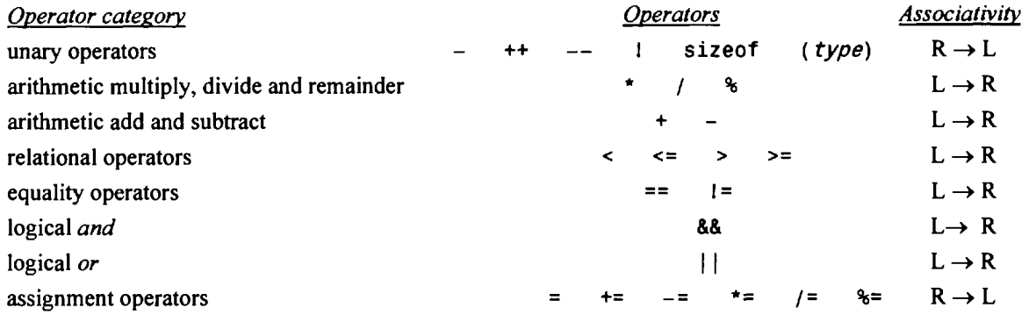
Operator Precedence

Slide 44
THANK YOU
……

